Slide 1



HEART DISEASE DIAGNOSTIC ANALYSIS
DETAILED PROJECT REPORT
Sham Ambadas Johari

Slide 2
CONTENTS
Problem Statement
Objective
Introduction
Architecture
Insights
Conclusions

Slide 3
PROBLEM STATEMENT
Health is real wealth in the pandemic time we all realized the brute effects of covid-19 on all irrespective of any status. You are required to analyze this health and medical data for better future preparation.

Slide 4
OBJECTIVE
The goal of this project is to analyse the heart disease occurrence, based on a combination of features that describes the heart disease.

Slide 5
Introduction
Heart disease is the leading cause of death in the world over the past 10 years.
The goal of this project is to analyse the heart disease occurrence , based on the combination of features that describes the heart disease.
There are several parameter such as high blood pressure, high cholesterol, fasting blood sugar, coronary artery disease(AHD) etc. for analysing the person have a heart disease or not.

Slide 6




ARCHITECTURE
Dataset
Importing
Libraries
Read Dataset
Missing value
Imputation
Report
Exploratory Data Analysis
Handling Outliers
Data
Cleaning
Data visualization
By using EDA.
Documentation for several graphs.

Slide 7
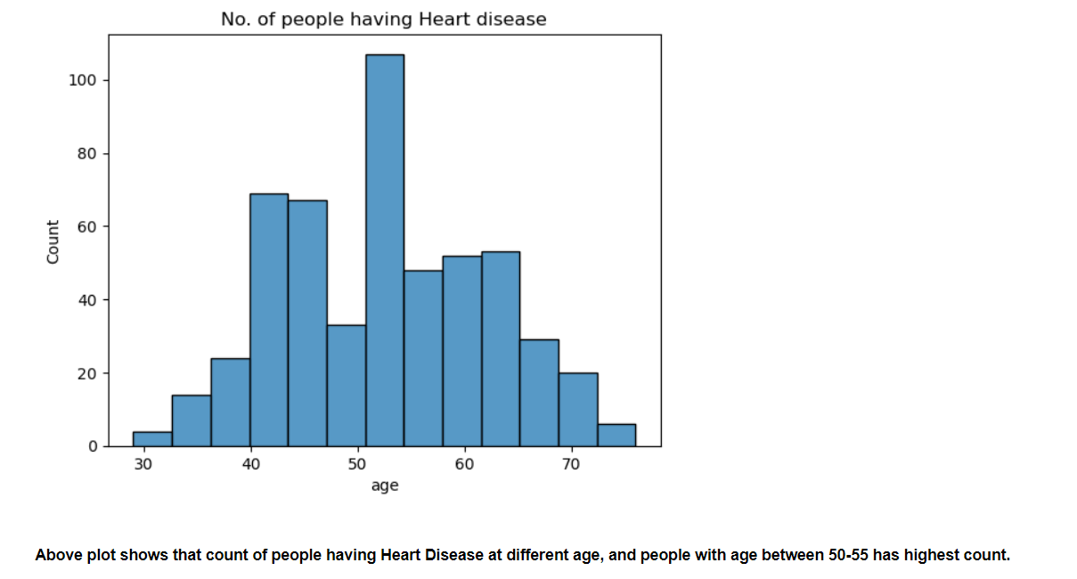
INSIGHTS FROM ANALYSIS

Slide 8
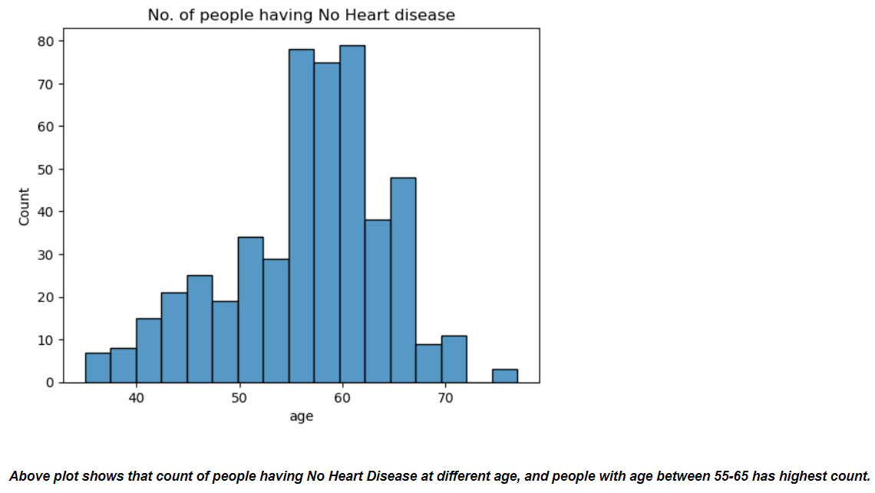

Slide 9
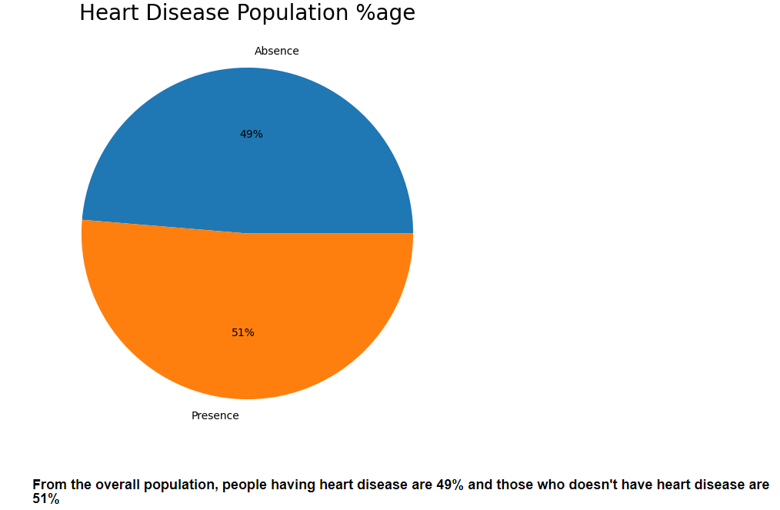

Slide 10
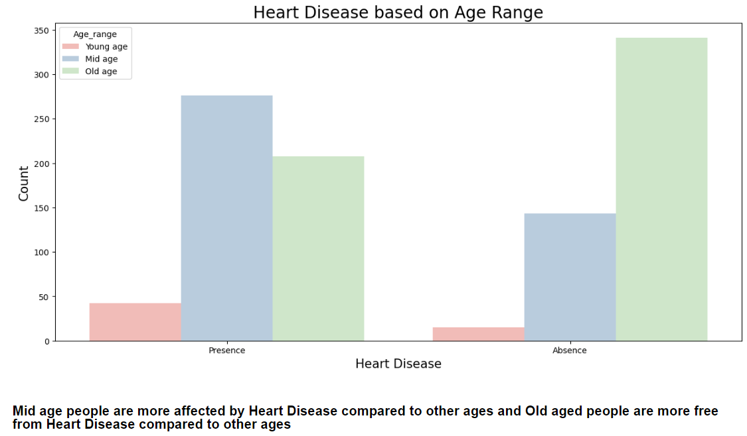

Slide 11
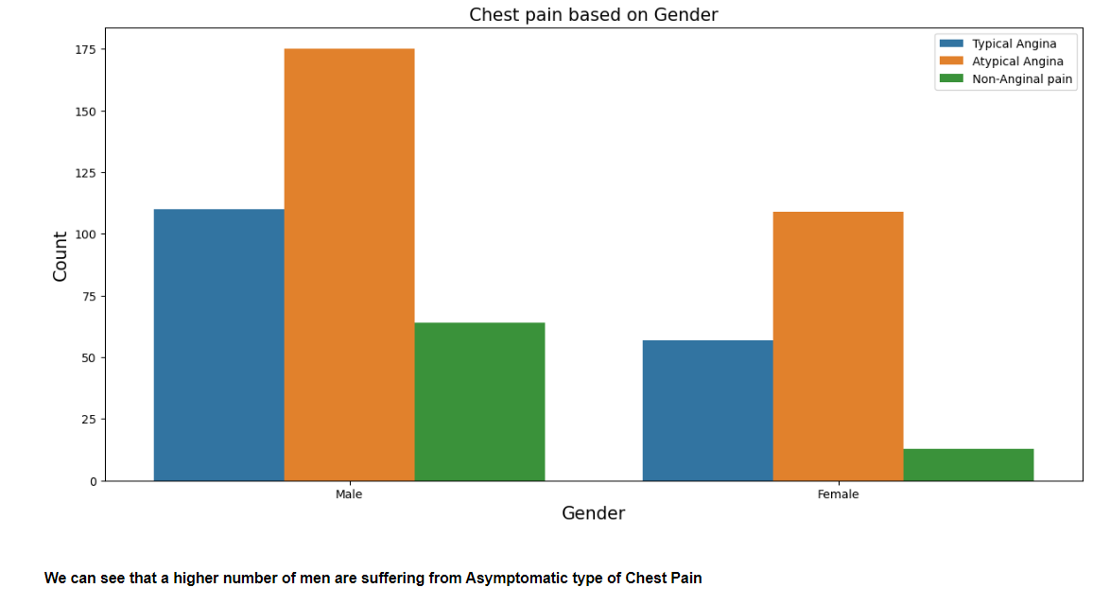

Slide 12
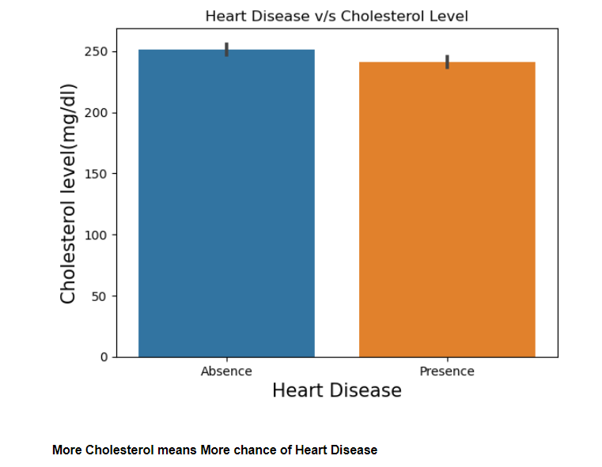

Slide 13
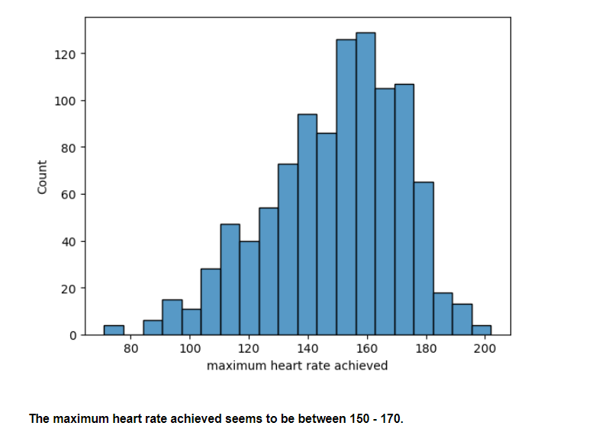

Slide 14
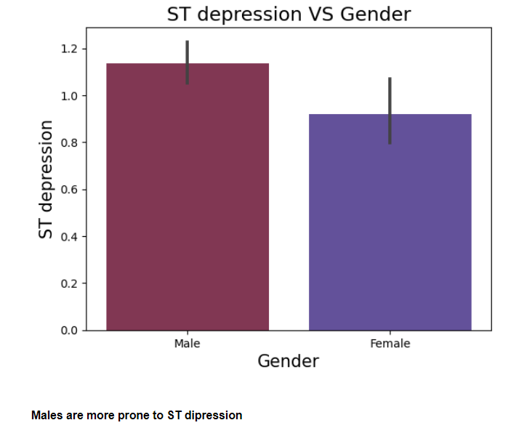

Slide 15
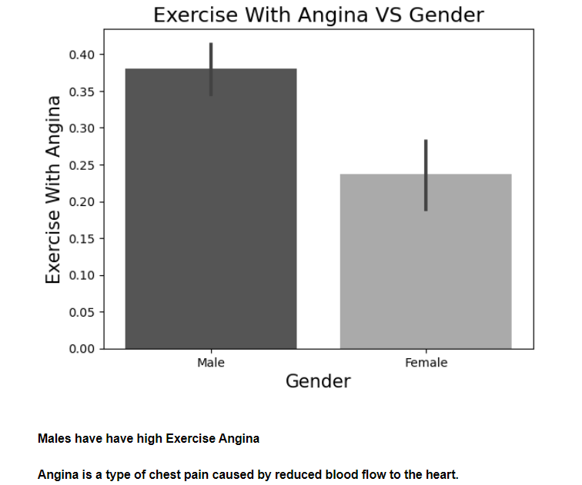

Slide 16
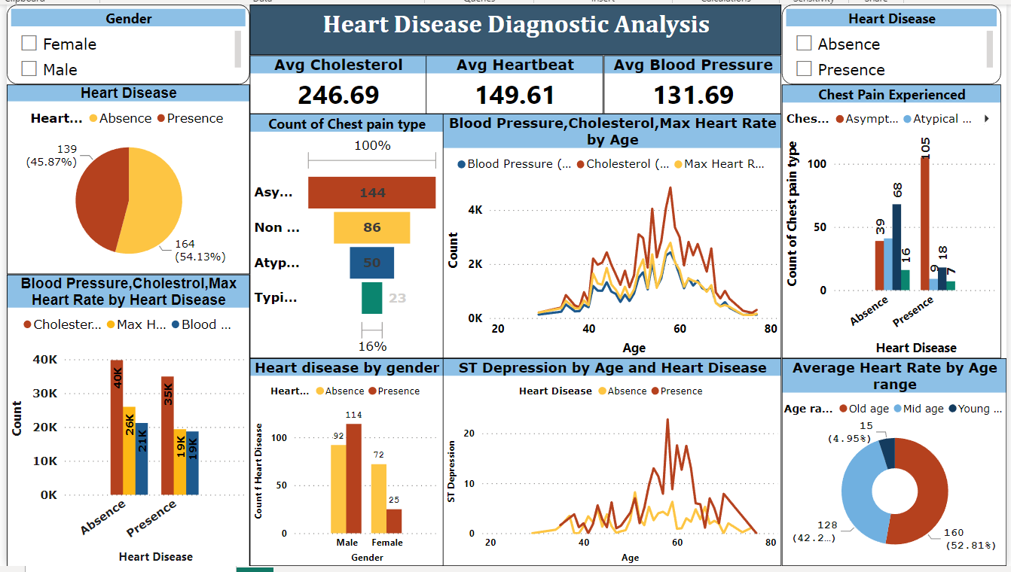

Slide 17
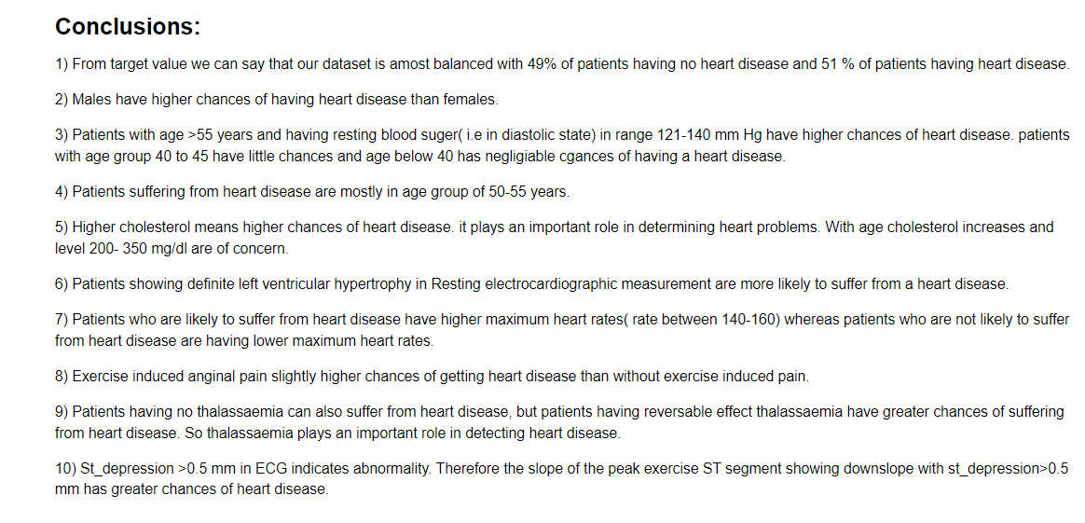

Slide 18

Thank You!!!

